Slide 1
Credit Card Default
MGMT 671 - Capstone Project
Bryan Butto
March 1, 2022

Slide 2
Executive Summary
Credit card default is costly to lenders
Important to determine which customers are likely to default and which are not
Project will classify customers as likely to default “yes” or “no”

Slide 3
Agenda
Study Objective
Data Set
Data Diagnostics
Modeling Results
Plotting the results
Study Conclusions
Future Studies
References

Slide 4
Study Objective
To predict whether someone will default on their credit card
The predictor variables that may affect credit card default are student, balance, and income
Objective
To build a classification model that can predict whether someone will default on their credit card
To determine which factors (student, balance, income) best predict credit card default

Slide 5

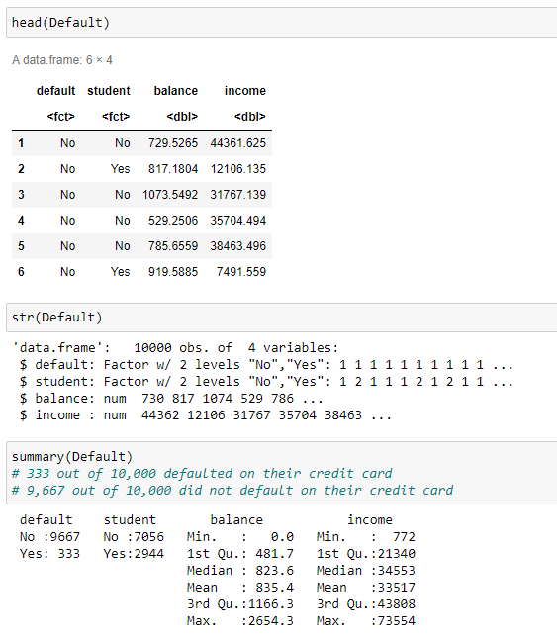
Data Set

Slide 6
Data Set
Data set – Default dataset from the ISLR library in R
The data set is composed of 10,000 observations of credit card data
Response variable – default, which is categorical variable (yes, no)
Predictor variables
student – yes or no if the person is a student
balance – the average balance that the customer has remaining on their credit card after making their monthly payment
income – the customer’s income

Slide 7
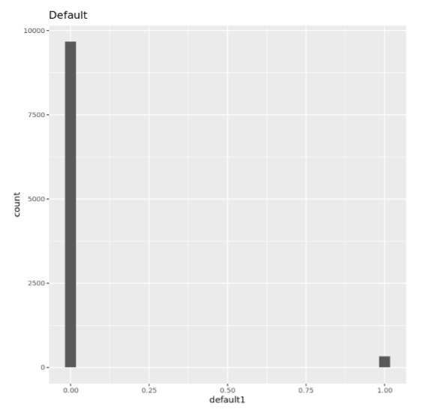
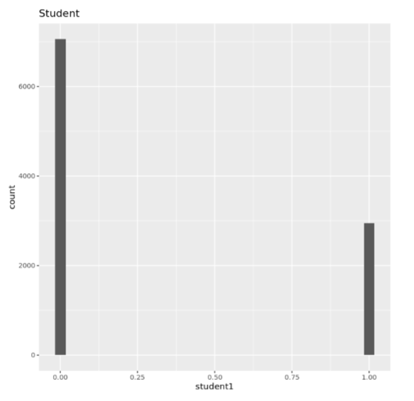
Data Diagnostics
Histogram of default
Histogram of student
Shows the disparity of observations for default and student variables

Slide 8
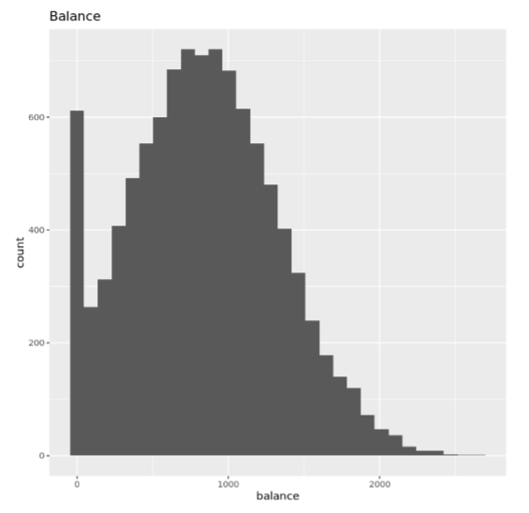
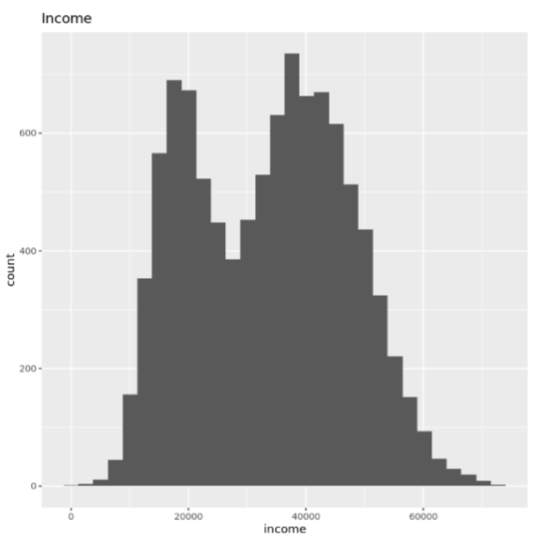
Data Diagnostics
Histogram of balance
Skewed right
High number of customers with zero balance
Histogram of income
2 tiers of peaks
Around $20,000
Around $40,000

Slide 9
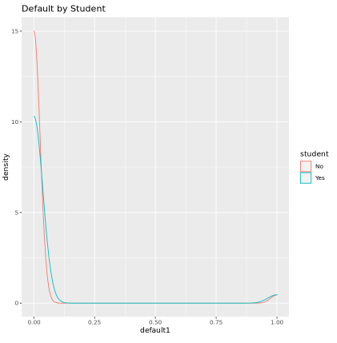
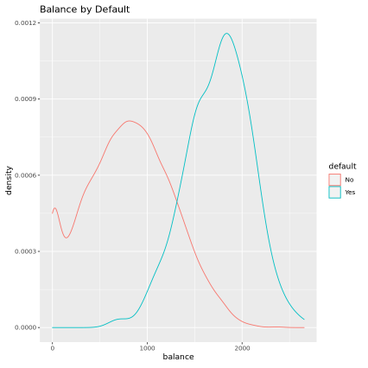
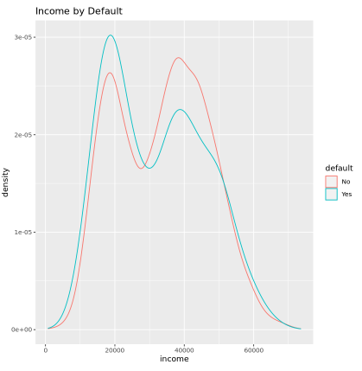
Data Diagnostics
Density plots for default vs predictor variables
Default appears to be more likely with a higher balance

Slide 10
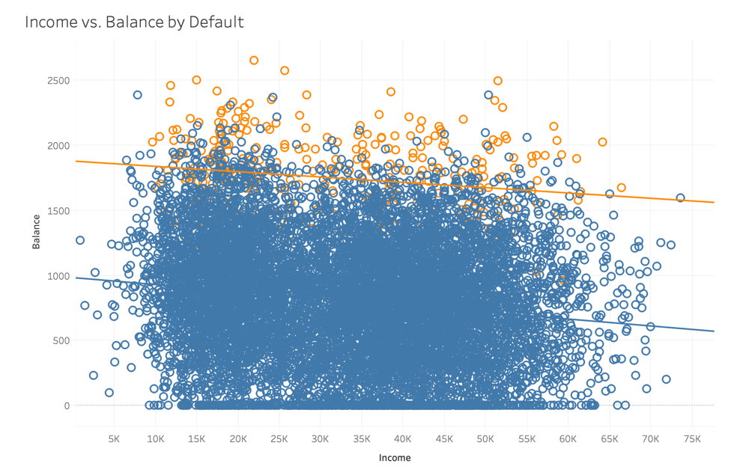
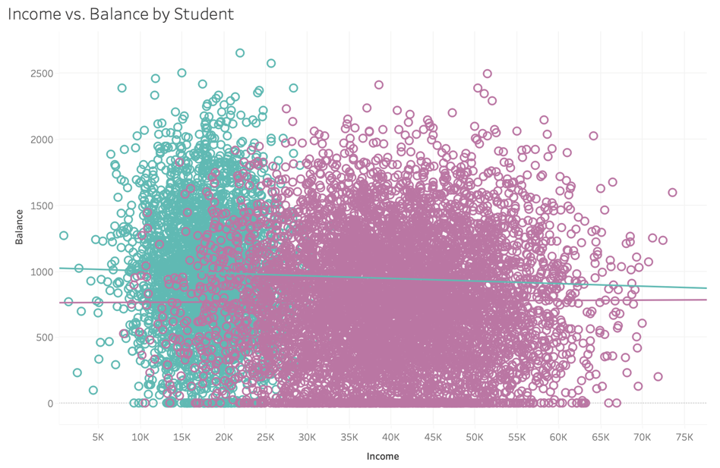
Data Diagnostics
Tableau scatterplot for balance vs. income broken out by default
Customers with higher balances tend to be more likely to default
Tableau scatterplot for balance vs. income broken out by student
Customers with lower incomes tend to be students

Slide 11
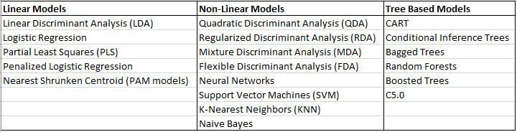
Modeling Results
19 total models run
3 different types of models
5 linear models
8 non-linear models
6 tree based models

Slide 12

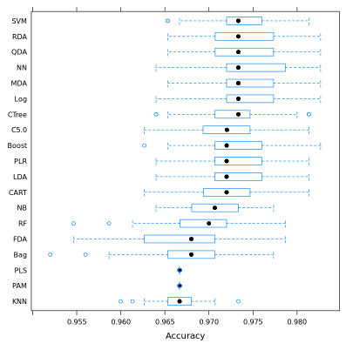
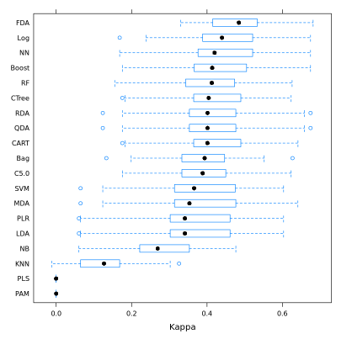
Modeling Results
Boxplots for accuracy and Kappa of training set

Slide 13
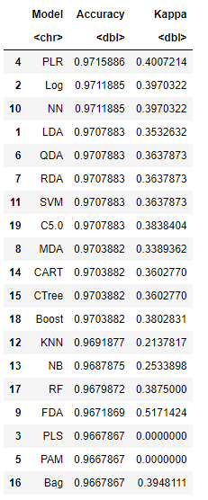
Modeling Results
19 different models were run
Penalized Logistic Regression, Logistic Regression, and Neural Networks performed the best
Accuracy > 97.1%
Kappa > 0.39
Partial Least Squares, Nearest Shrunken Centroid (PAM), and Bagged Trees performed the worst
Accuracy < 96.7%

Slide 14
Modeling Results
Linear Models
2 performed in the top 3
2 performed in the bottom 3
Non-linear Models
Average performance in comparison to other models
Neural Networks performed in top 3
Tree based models
Performed averaged to below average in comparison to other models
Bagged Trees performed in bottom 3

Slide 15
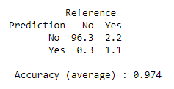
Modeling Results
Confusion matrix for Penalized Logistic Regression
98.7% accuracy to predict customers who did not default on their credit card
78.6% accuracy to predict customers who did default on their credit card
More accurate in predicting customers who did not default on their credit card due to more than 96% of observations falling in that category

Slide 16
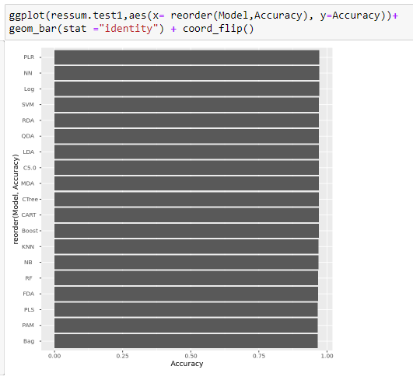
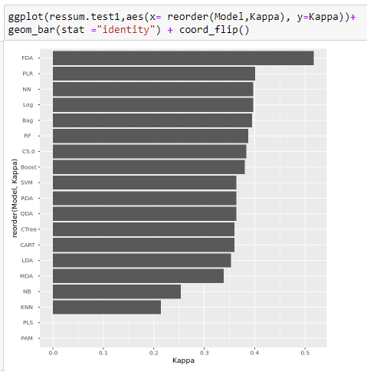
Plotting the Results
Accuracy ranged from 96.68% - 97.16%

Slide 17
Study Conclusions
All 19 models built were able to accurately predict credit card default between 96.68% and 97.16%
Penalized Logistic Regression was the most accurate model
Linear Model
97.16%
Balance was the best predictor variable for credit card default

Slide 18
Future Studies
Improve models
Tuning parameters
Extended Grid searches
Look at other possible variables
Marital status
Gender
Education level
Credit card limit

Slide 19
References
Default dataset. ISLR library. R package
Classification for credit card default - GitHub Pages. (n.d.). Retrieved February 26, 2022, from http://inseaddataanalytics.github.io/INSEADAnalytics/CourseSessions/ClassificationProcessCreditCardDefault.html
Selener. (2019, May 19). Prediction of credit card default. Kaggle. Retrieved February 26, 2022, from https://www.kaggle.com/selener/prediction-of-credit-card-default

